Slide 1
Digital Control and Automatic Control
Instructor: Sanghyuk Lee
Sanghyuk.Lee@xjtlu.edu.cn
Tel: 8816-1415
Department of Electrical and Electronic Engineering
XJTLU

Slide 2
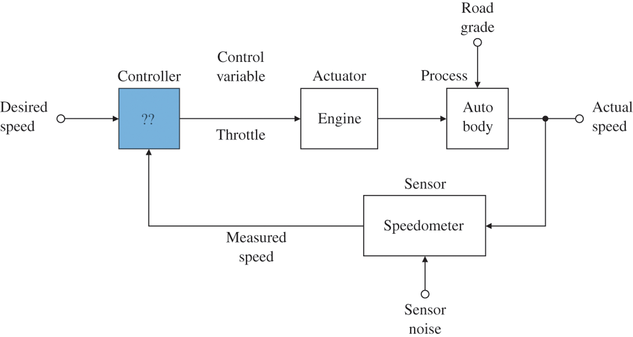
Digital Control and Automatic Control EEE327
Module Code: EEE327
Originating Department: Electrical & Electronic Engineering
Module Level: Level 4
Module Credit: 2.5
Instructor: Sanghyuk Lee
Sanghyuk.Lee@xjtlu.edu.cn
Tel: 8816-1415

Slide 3
Digital Control and Automatic Control EEE327
AIM of Module:
To familiarize control theory, signal flows, simulation tools
To equip knowledge of analysis and design of automatic control systems(Continuous/Discrete system)
Learning Outcomes:
A better understanding of linear systems
An ability to develop system models, and use them to design feedback control laws to stabilize system
Good understanding of how to control continuous systems via digital controller

Slide 4
Digital Control and Automatic Control EEE327
Method of Teaching and Learning:
Formal Lecture (1.5 hrs./week)
Tutorials-Problem solving in lecture hour (2 times)
Q&A in Office times (2-4 pm/Mon. 9-11 am/Thu.)
Assessment:
Final Exam-70%, Midterm Exam-15%
Two times Assignments-15%

Slide 5
Digital Control and Automatic Control EEE327
Essential texts:
Modern Control Systems, Richard C. Dorf, Robert H. Bishop, Pearson
References:
Feedback Control of Dynamic Systems, G.F. Franklin, J.D. Powell, Abbas E-N, 6th ed.
Automatic Control Systems, B.C. Kuo
Modern Control Engineering, K. Ogata
Teaching Material:
Lecture Notes by Instructor

Slide 6
Digital Control and Automatic Control EEE327
Brief Syllabus(1):
Overview and Feedback Control(1 week)
Review/Dynamic models & system(1 week)
Review/Feedback stability & Root Locus(2 weeks)
Fuzzy control method(2 weeks)
One time Assignment is planned
Mid Exam is planned (Week 7)

Slide 7
Digital Control and Automatic Control EEE327
Brief Syllabus(2):
Frequency response design(1 week)
State space controller design(2 weeks)
Digital controller design(2 weeks)
Control system: Case study(1 week)
One time Assignment is planned
Final Exam

Slide 8
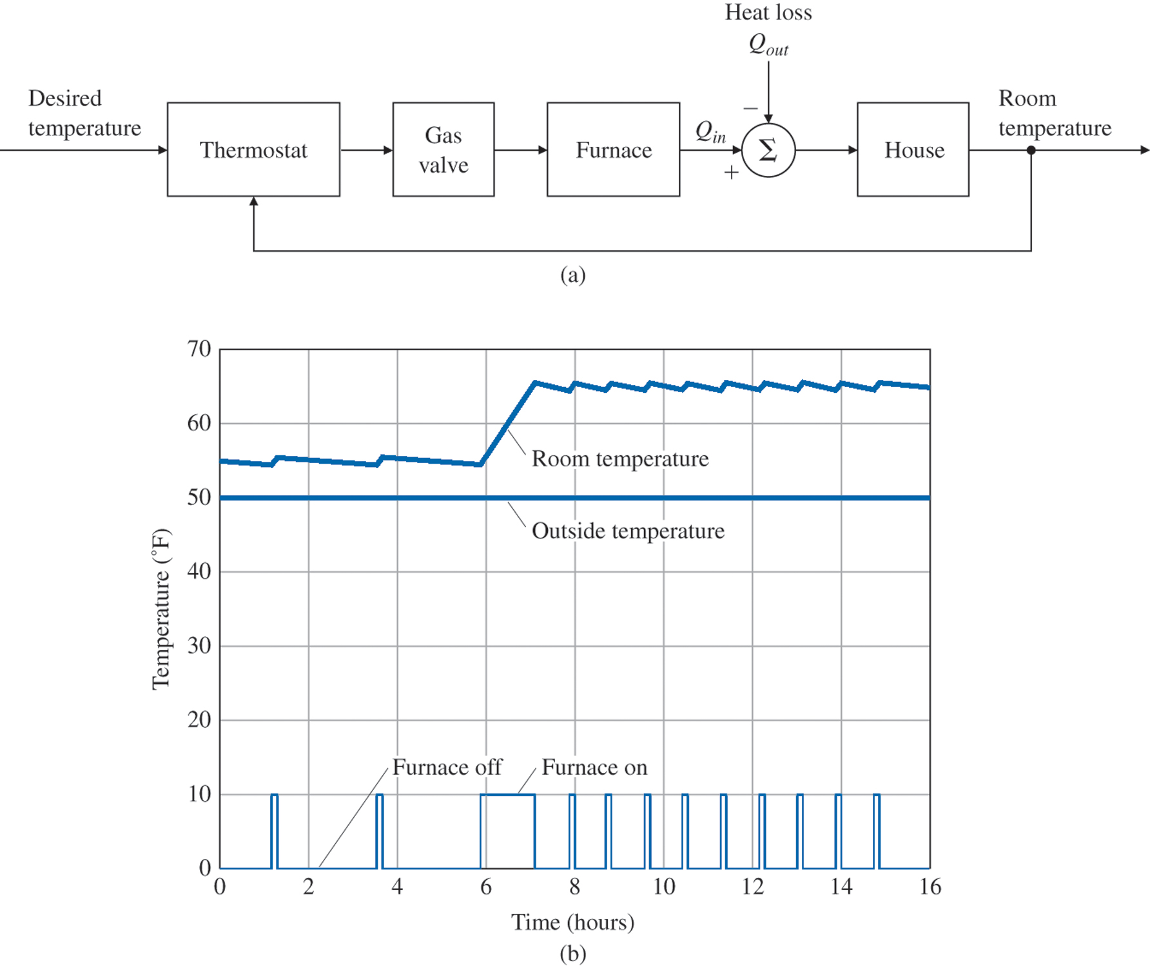
Figure 1.1 (a) Component block diagram of a room temperature control system; (b) plot of room temperature and furnace action
Digital Control and Automatic Control EEE327

Slide 9

Figure 1.3 Component block diagram of automobile cruise control
Digital Control and Automatic Control EEE327
How to design controller ?
Time Domain
Frequency domain
What’s the control objective ?
$L_{2}$ sense
$H_{∞}$criteria
Methods ?
PID/ Adaptive/Robust/Optimal/fuzzy

Slide 10
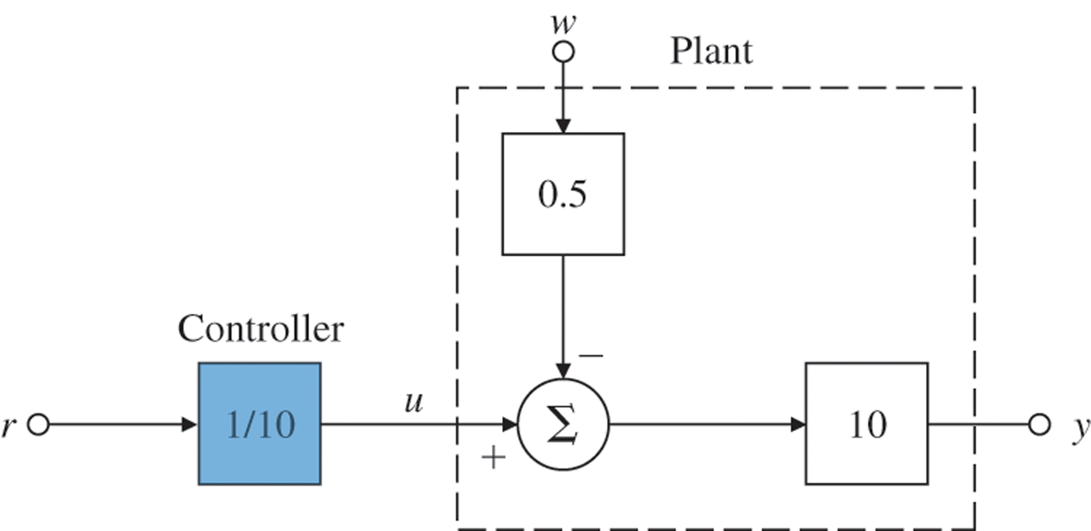
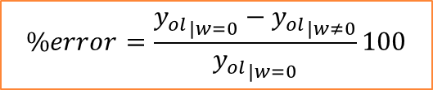
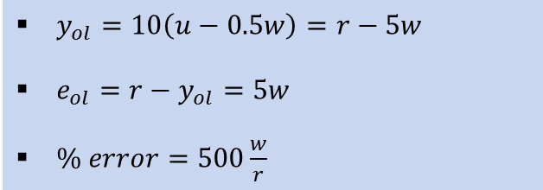
Digital Control and Automatic Control EEE327
$y_{ol}=10\left(u−0.5w\right)=r−5w$
$e_{ol}=r−y_{ol}=5w$
$\% error=500\frac{w}{r}$
$$\%error=\frac{{y_{ol}}_{|w=0}−{y_{ol}}_{|w≠0}}{{y_{ol}}_{|w=0}}100$$
Figure 1.5 Open-loop cruise control
Analysis: for r = 65 and w = 0, there is no error
when w = 1%, then y = 60, it results 7.69% error speed
Typical example of open loop system
It has the weak point over exterior disturbance
Need to adjust input variable u by comparison with output y

Slide 11
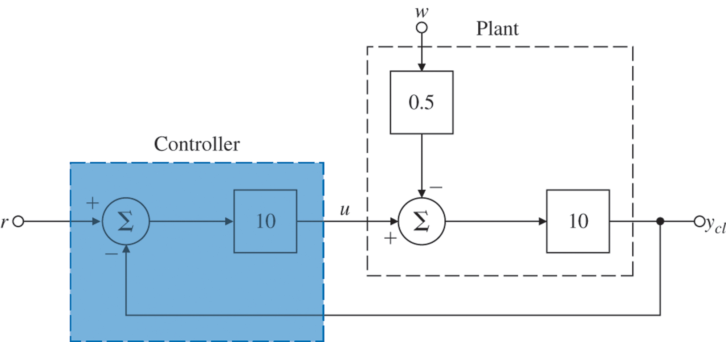
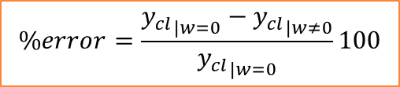
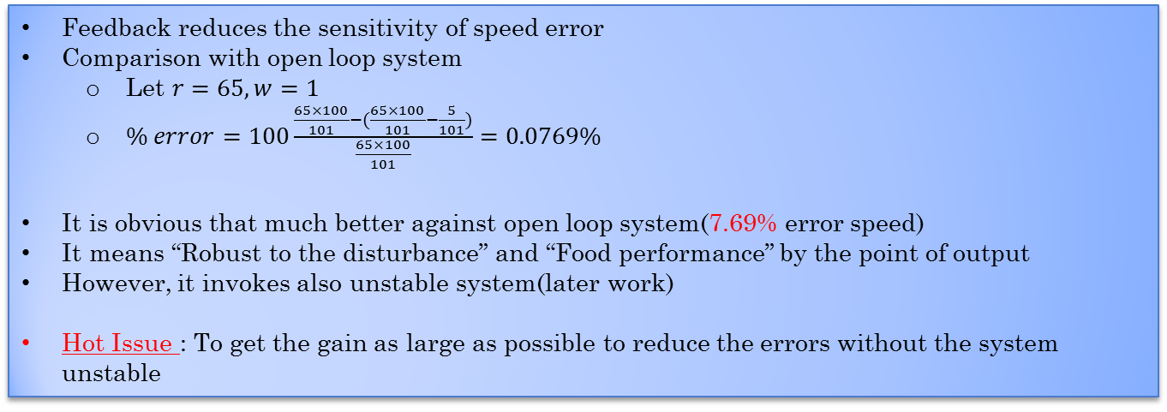
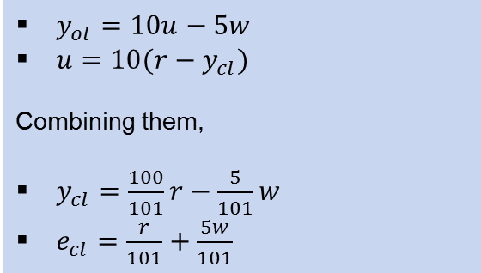
Figure 1.6 Closed-loop cruise control
Digital Control and Automatic Control EEE327
Large loop gain over open loop control structure
$y_{ol}=10u−5w$
$u=10(r−y_{cl})$
Combining them,
$y_{cl}=\frac{100}{101}r−\frac{5}{101}w$
$e_{cl}=\frac{r}{101}+\frac{5w}{101}$
Feedback reduces the sensitivity of speed error
Comparison with open loop system
Let $r=65, w=1$
$\% error=100\frac{\frac{65×100}{101}−(\frac{65×100}{101}−\frac{5}{101})}{\frac{65×100}{101}}=0.0769\%$
It is obvious that much better against open loop system(7.69% error speed)
It means “Robust to the disturbance” and “Food performance” by the point of output
However, it invokes also unstable system(later work)
Hot Issue : To get the gain as large as possible to reduce the errors without the system unstable
$$\%error=\frac{{y_{cl}}_{|w=0}−{y_{cl}}_{|w≠0}}{{y_{cl}}_{|w=0}}100$$

Slide 12
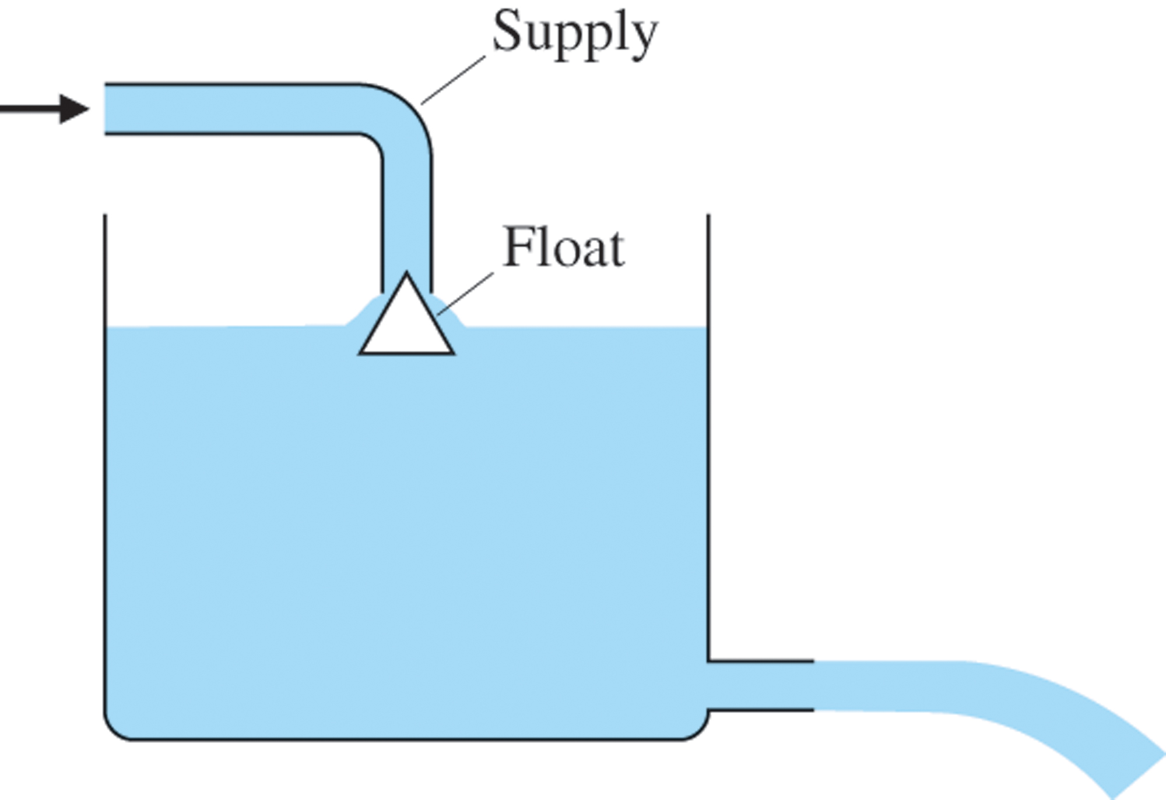
Figure 1.7 Early historical control of liquid level and flow
Digital Control and Automatic Control EEE327
Previous Control System Examples (1)
System Object: maintain water flow properly
System Controller: Float
Source: Water supply from outside
Is this System open loop or closed loop ?
What is sensor?
What is actuator?
What is system output ?

Slide 13
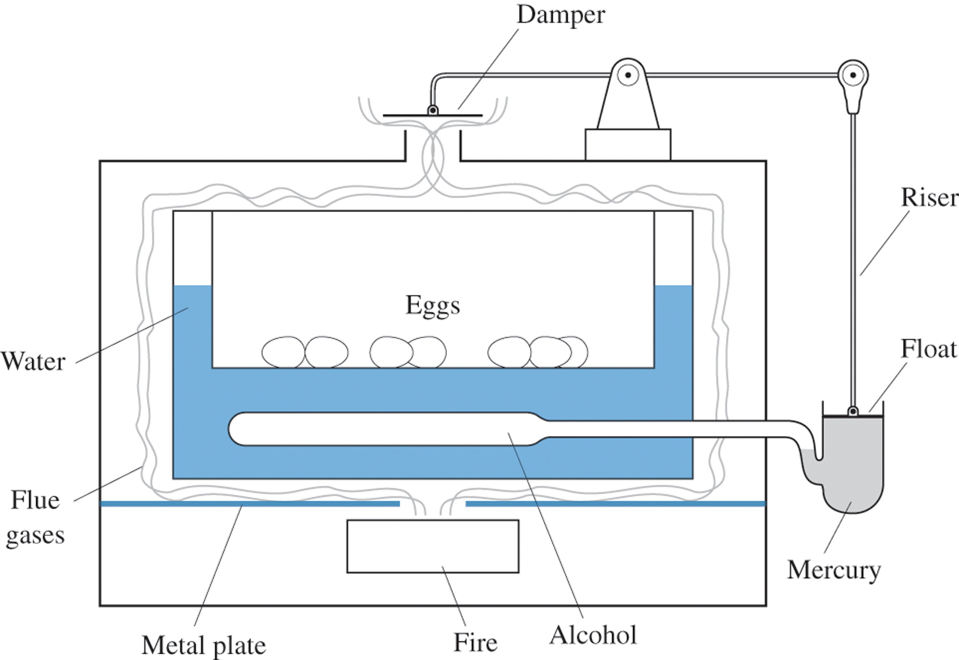
Figure 1.8 Drebbel’s incubator for hatching chicken eggs Source: Adapted from Mayr, 1970
Digital Control and Automatic Control EEE327
Previous Control System Examples (2)
System Object: maintain temperature to incubate eggs
System Controller: Damper
Source: Flue gas heat from fire
Is this System open loop or closed loop ?
What is sensor? Alcohol(expand/contract)
What is actuator? Damper/riser/float

Slide 14
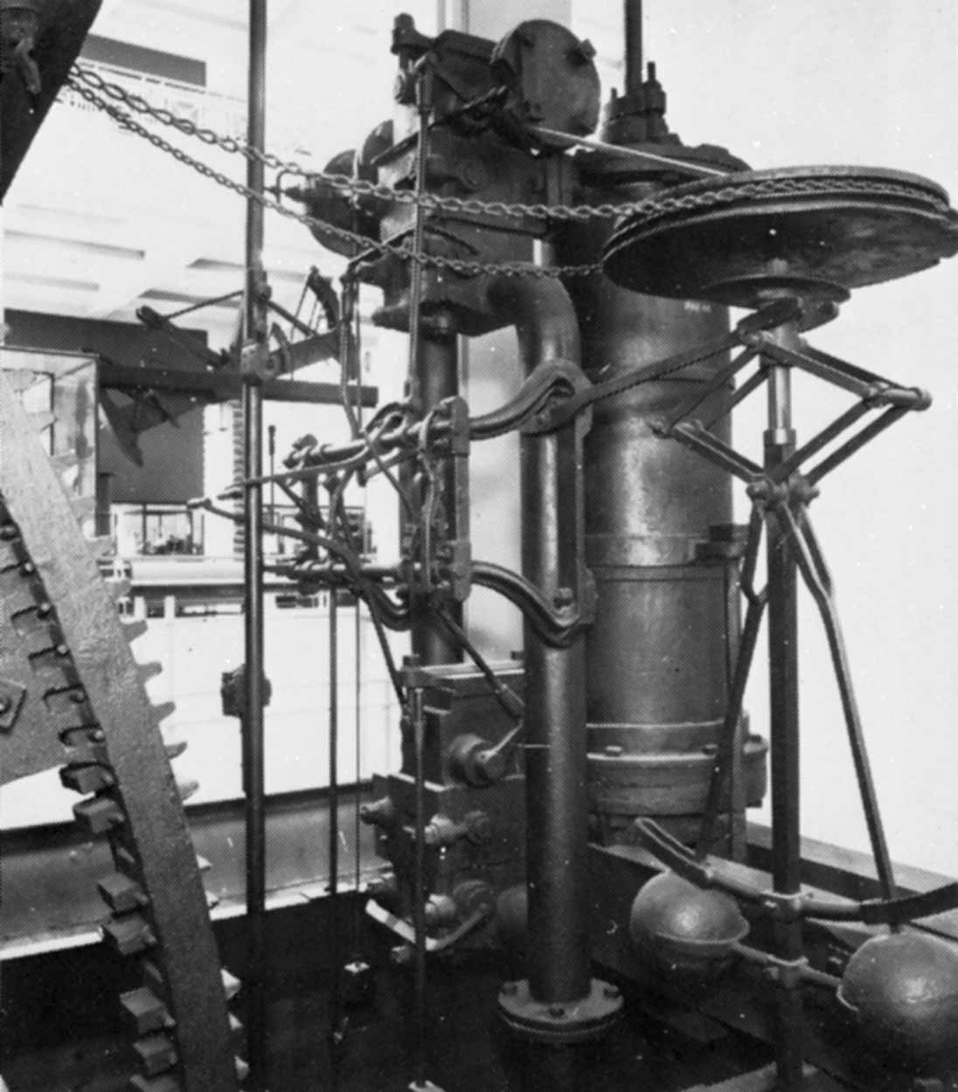
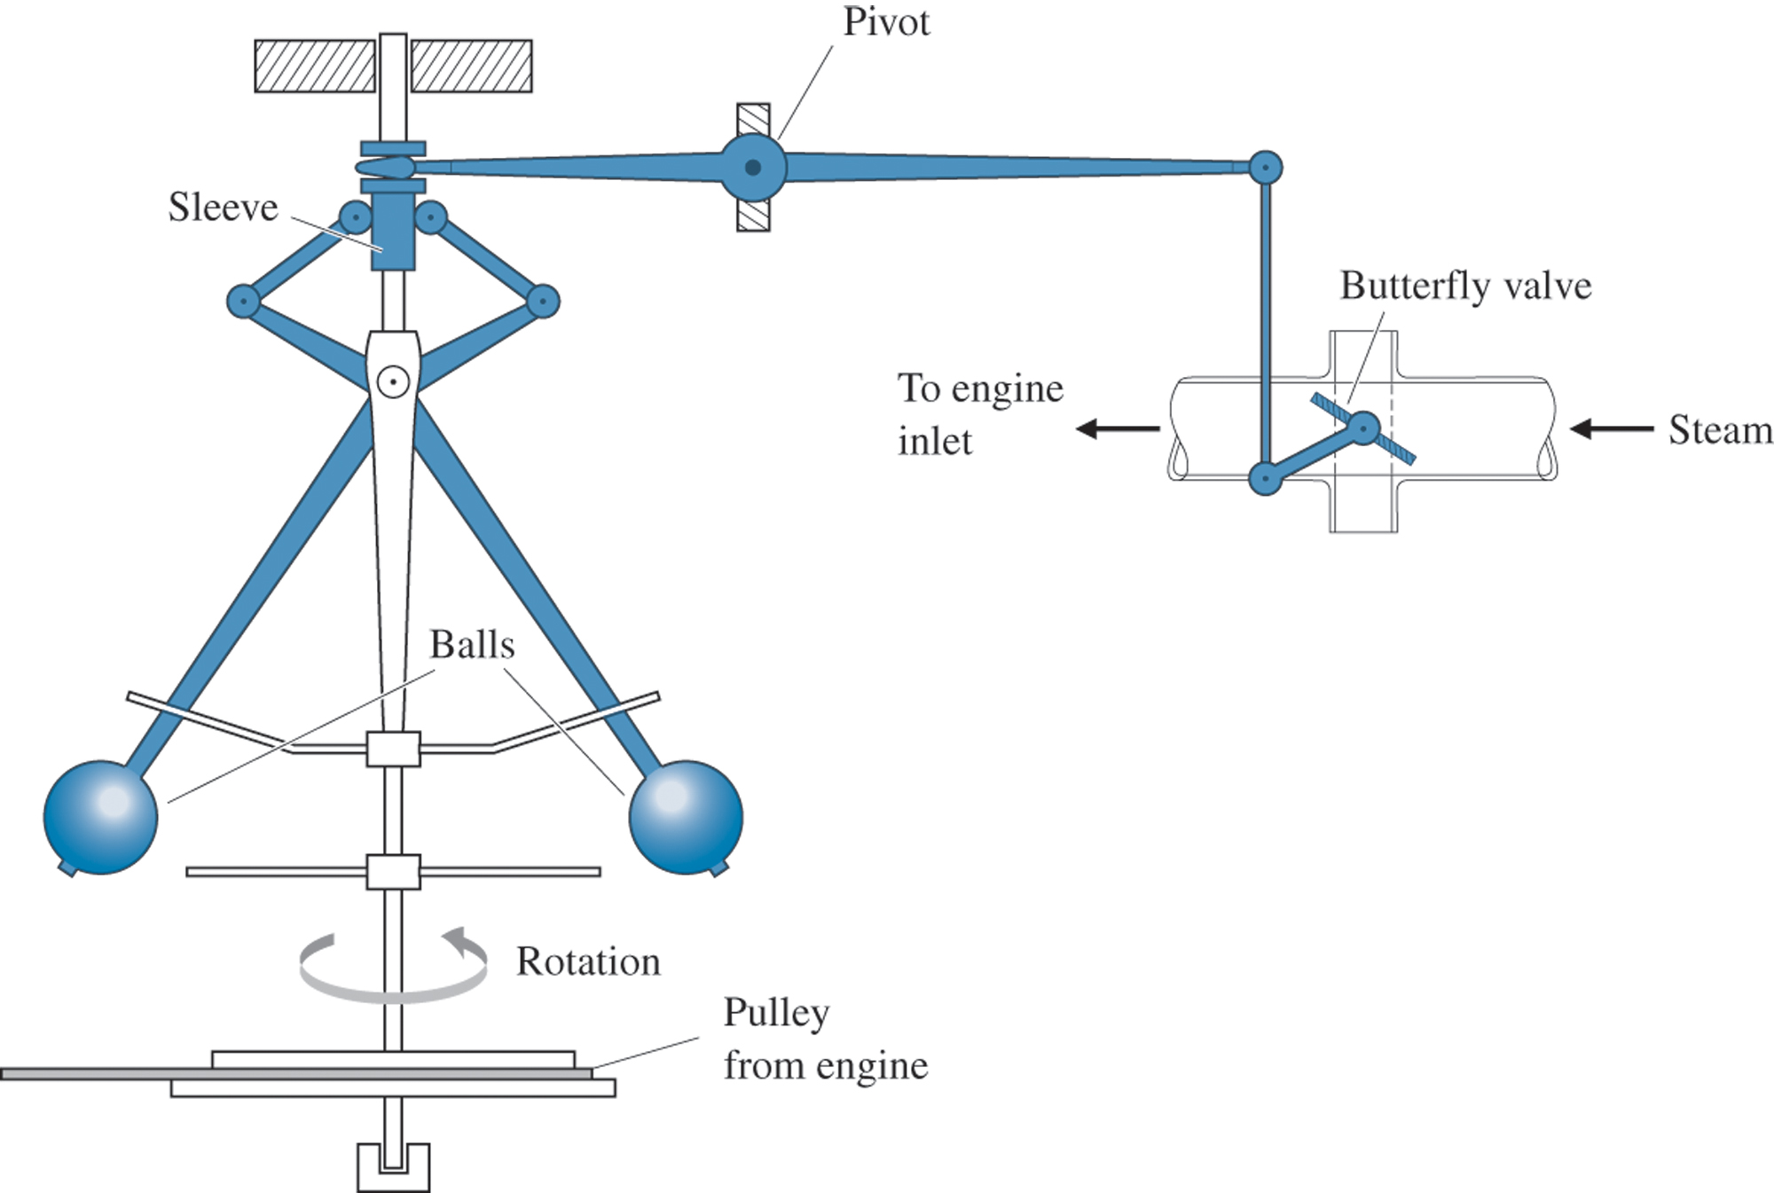
Figure 1.10 Close-up of the fly-ball governor Source: British Crown Copyright, Science Museum, London
Digital Control and Automatic Control EEE327
Previous Control System Examples (3)
Figure 1.11 Operating parts of a fly-ball governor
Is this System open loop or closed loop ?
What is sensor? Ball angle
What is actuator? Lever to open main valve
1st Load change
2nd Speed variation make ball angle change
3rd Sleeve --> lever
4th Steam flow change

Slide 15
Digital Control and Automatic Control EEE327
Surveys of Control Theory
At first, control system was designed through just experience not theoretical point of view
Later, G.B Airy(1820s to 1840s): discuss instability in a feedback system using differential eq.
Stability Analysis
J.C. Maxwell(1868) stated that stability depends on the roots of characteristic equation
R.E Routh(1877) introduced stability criterion with simple technique
A.M. Lyapunov(1893) studied stability of motion which was based on nonlinear differential eq.
Frequency Response
Problem of amplifier(need many amplifier for long distance telephoning)
It needed feedback structure(less error)
Except high gain, higher dimension problem
Solved by Nyquist(1932) and Bode(1945)
Root locus
W.R Evans(1948) developed techniques and rules to follow the paths of roots of the characteristic eq.
Suitable for design, stability analysis
State variable/Modern control
Bellman, Kalman and Pontryagin(1950s) began again to consider ODE which was stimulated by the control of earth satellites
Optimal control(Wiener and Phillips during World War 2)
This method use ODE directly not use
frequency response or characteristic eq.
PID Control
Callender et al (1936) described first
Based on experimental work
Proper for process having relatively long time delay between actuator and sensor
Applicable not only complex but also nonlinear
As a result, very popular

Slide 16
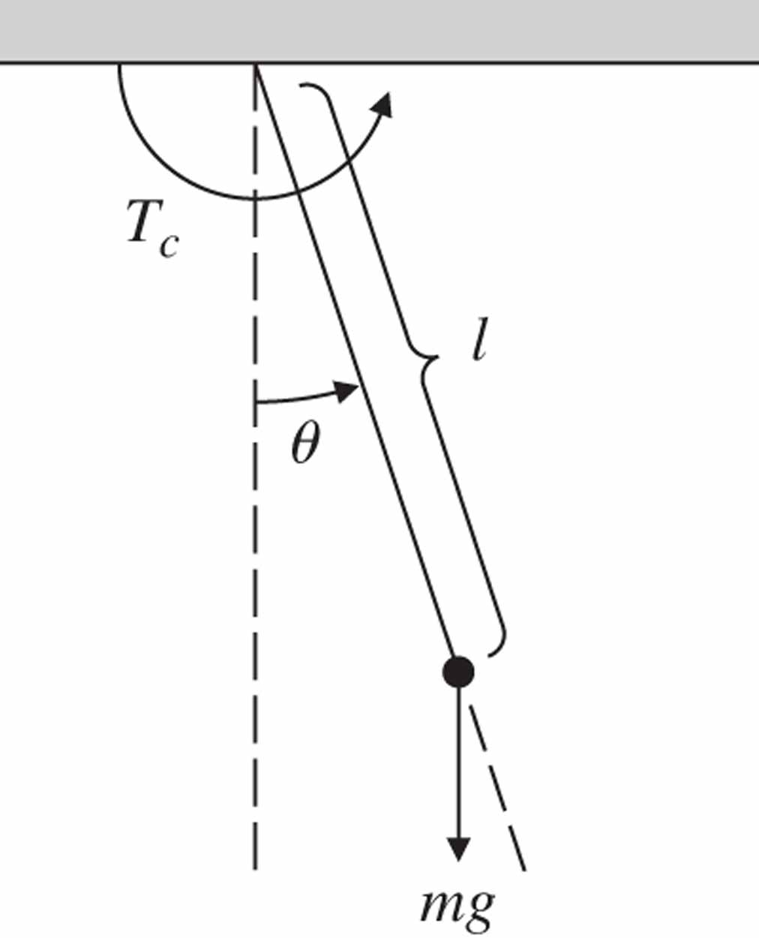
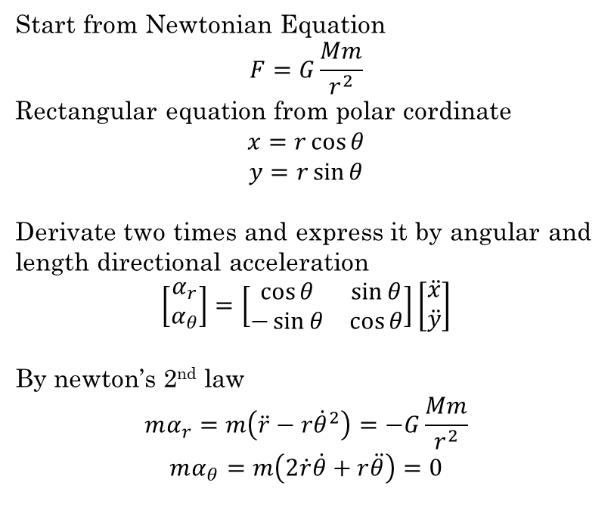
Digital Control and Automatic Control EEE327
Process of designing control system
Study the system controlled: Decide sensors, actuators, etc.
Modelling the system : Time domain, Frequency domain, state space approach, etc.
What is sensor, and actuator ?
Modelling process
Start from Newtonian Equation
$$F=G\frac{Mm}{r^{2}}$$
Rectangular equation from polar cordinate
$$x=r\cos{θ}$$
$$y=r\sin{θ}$$
Derivate two times and express it by angular and length directional acceleration
$$\left[\begin{matrix}α_{r} \\ α_{θ}\end{matrix}\right]=\left[\begin{matrix}\cos{θ} & \sin{θ} \\ −\sin{θ} & \cos{θ}\end{matrix}\right]\left[\begin{matrix}\ddot{x} \\ \ddot{y}\end{matrix}\right]$$
By newton’s 2nd law
$$mα_{r}=m\left(\ddot{r}−r{\dot{θ}}^{2}\right)=−G\frac{Mm}{r^{2}}$$
$$mα_{θ}=m\left(2\dot{r}\dot{θ}+r\ddot{θ}\right)=0$$
Figure 2 pendulum

Slide 17
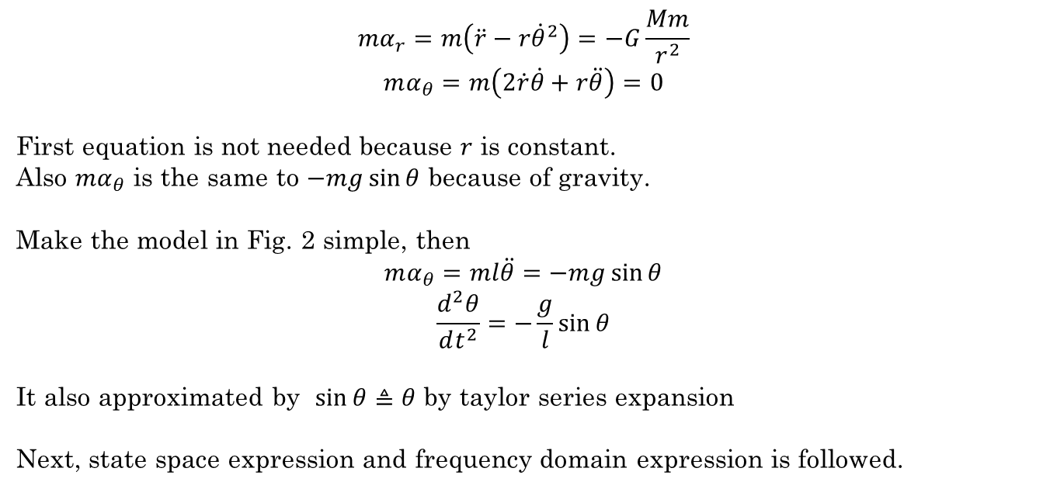
Digital Control and Automatic Control EEE327
Process of designing control system
Simply the model if necessary
Analyze the resulting model
$$mα_{r}=m\left(\ddot{r}−r{\dot{θ}}^{2}\right)=−G\frac{Mm}{r^{2}}$$
$$mα_{θ}=m\left(2\dot{r}\dot{θ}+r\ddot{θ}\right)=0$$
First equation is not needed because $r$ is constant.
Also $mα_{θ}$ is the same to $−mg\sin{θ}$ because of gravity.
Make the model in Fig. 2 simple, then
$$mα_{θ}=ml\ddot{θ}=−mg\sin{θ}$$
$$\frac{d^{2}θ}{dt^{2}}=−\frac{g}{l}\sin{θ}$$
It also approximated by $\sin{θ}≜θ$ by taylor series expansion
Next, state space expression and frequency domain expression is followed.

Slide 18
Digital Control and Automatic Control EEE327
Process of designing control system
Decide on the type of controller to be used
Design a controller to meet the spec.
Simulate the resulting controlled system: on computer simulation or pilot plant
From state space expression and frequency domain expression, controller is proposed such as
PID, Optimal, Adaptive, Robust, Intelligent, etc..
Check the specification, whether it is satisfied or not.(Simulation/Experiment)
Choose hardware and software and implement the controller
Tune the controller on-line if necessary

Slide 19
Digital Control and Automatic Control
End of Lecture 1

